Slide 1

Network Topology
Visualization
Michel de Boer - s1011542
Lorenzo Casini - s1062069
Onno de Gouw - s1025613
Stefan Popa - s1027672
Group 4 | Advanced Network Security
Radboud University
13-12-2021

Slide 2
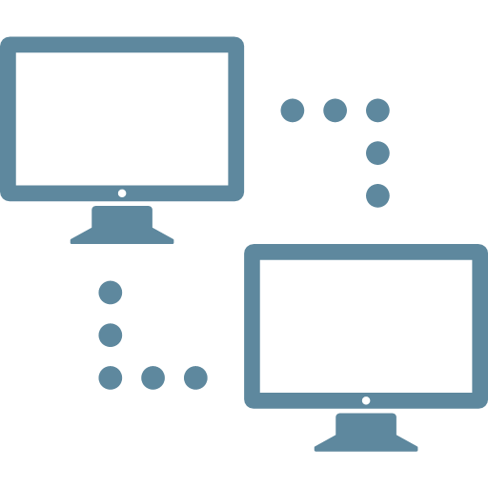
BGP Network Topology
Goals
Define and measure nodes of interest
Gather data with the right tools
Visualize results

Slide 3
Tools
Data Gathering
Icmplib
Ipinfo
Aslookup
Visualization
Django
Jquery
Chart.js
Openlayers
Debugging
Wireshark
Dropwatch

Slide 4
Measurements & Data
Measurements:
Parsing handled by packages
Stored using Django database model
SQL access and insertion
Data extracted and converted to JSON
Data:
Top 100 websites
Newspaper websites + social media
VPN

Slide 5
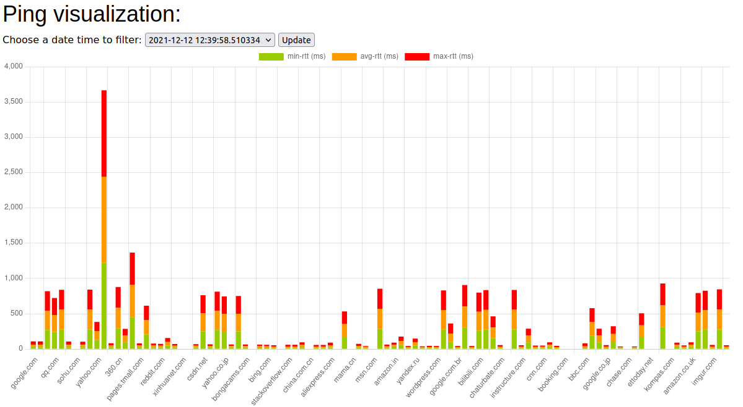
Ping Visualization
Min-rtt, average, max

Slide 6
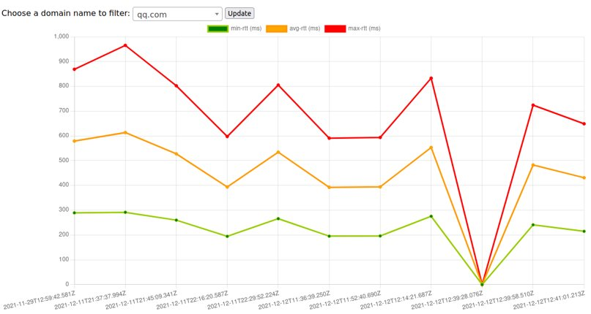
Ping Visualization
Timeline visualization for host

Slide 7
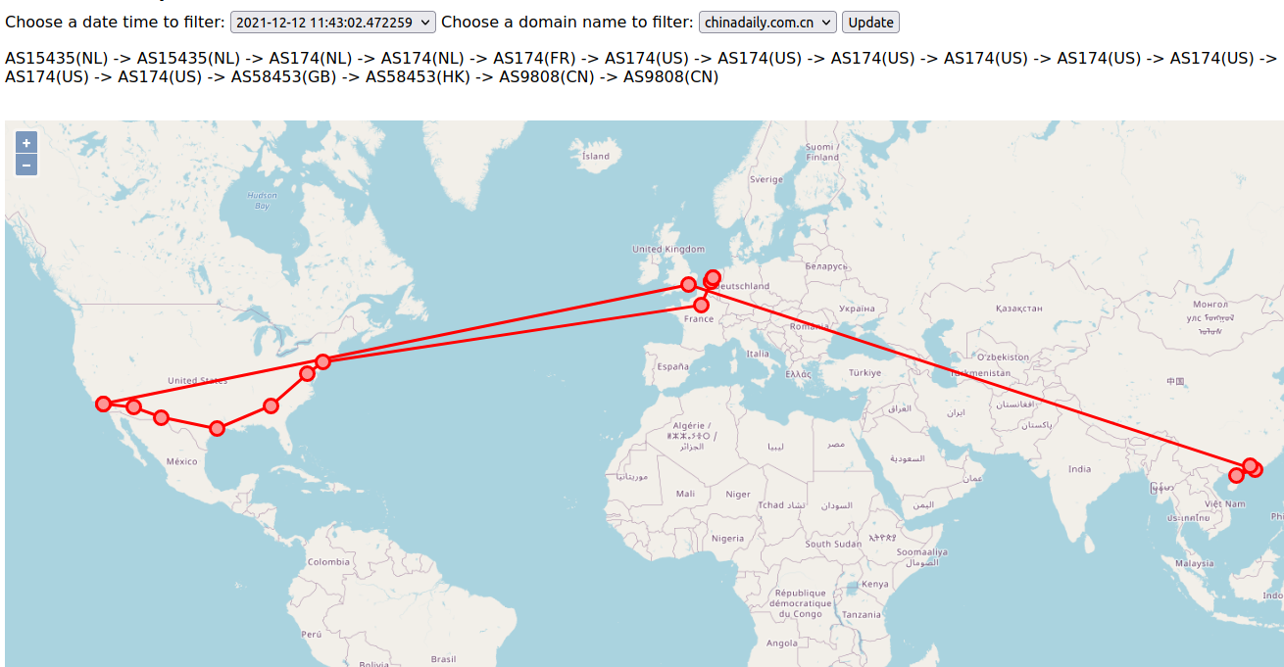
Traceroute Visualization
AS number + Countrycode path and Map (geolocation)

Slide 8
DEMO

Slide 9
Results
Chinadaily.com.cn
No VPN vs. VPN

Slide 10
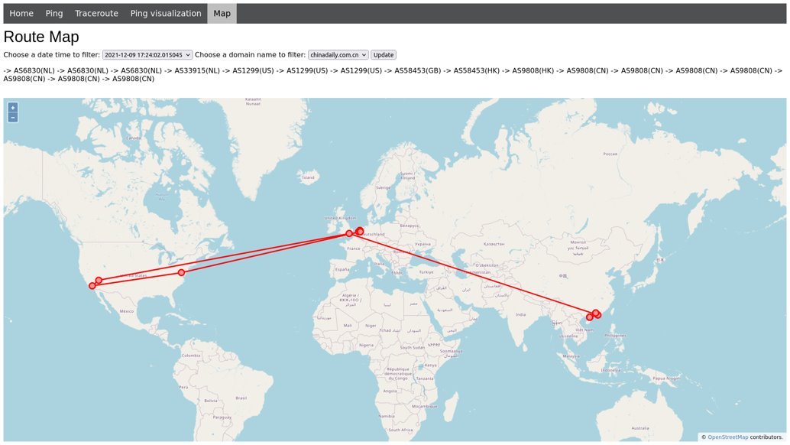
Chinadaily.com.cn (No VPN)

Slide 11
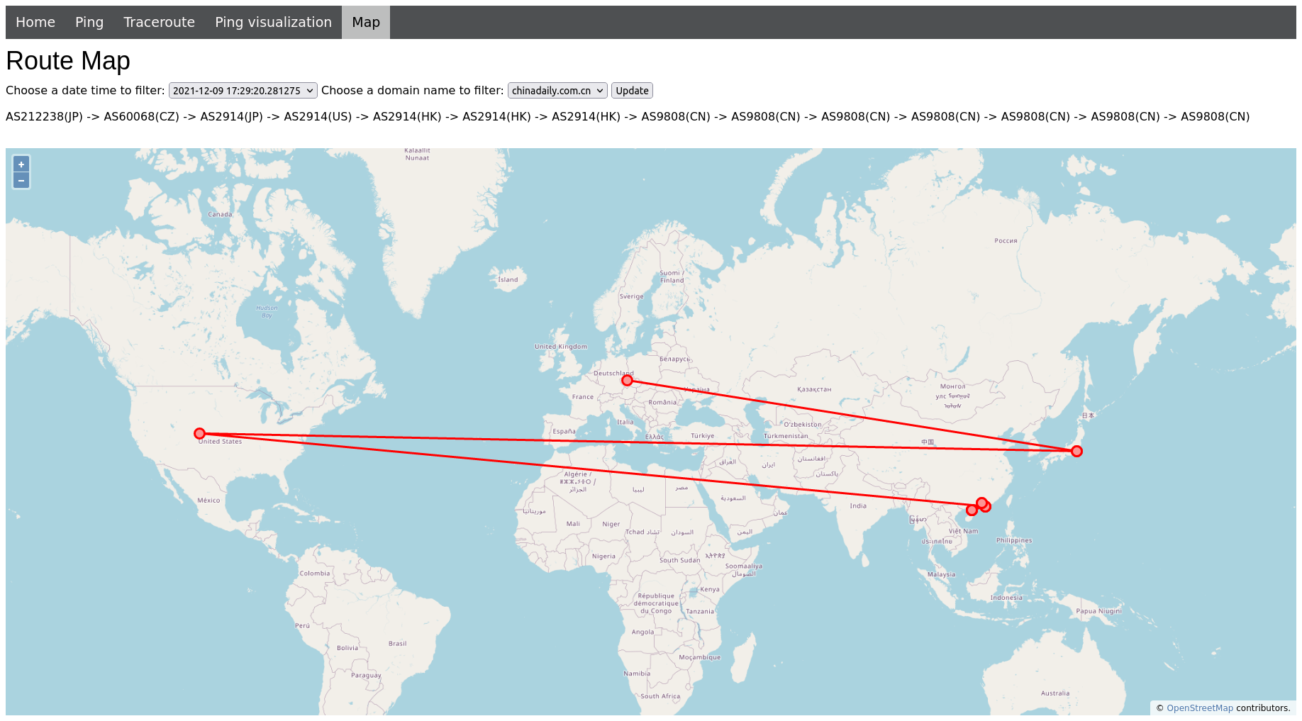
Chinadaily.com.cn (Japan: VPN)
Note: Starting point is visited twice sometimes!

Slide 12
Limitations
Corelation ping & traceroute
Possibly different paths
Use 1 specific API/database for the GeoIP lookup
Different API’s might return different locations
Difficult to explain routing decisions
No ground-truth
Network unreliable
Packet drop by kernel if hugely parallel
Debugging can be difficult and time consuming (dropwatch, wireshark)

Slide 13
QUESTIONS?

